Slide 1
Randomized Algorithms CS648A
Lecture 13
Random Sampling
Estimating a parameter (Final)
To find a subset with a desired property

Slide 2
Recap of the previous lecture

Slide 3

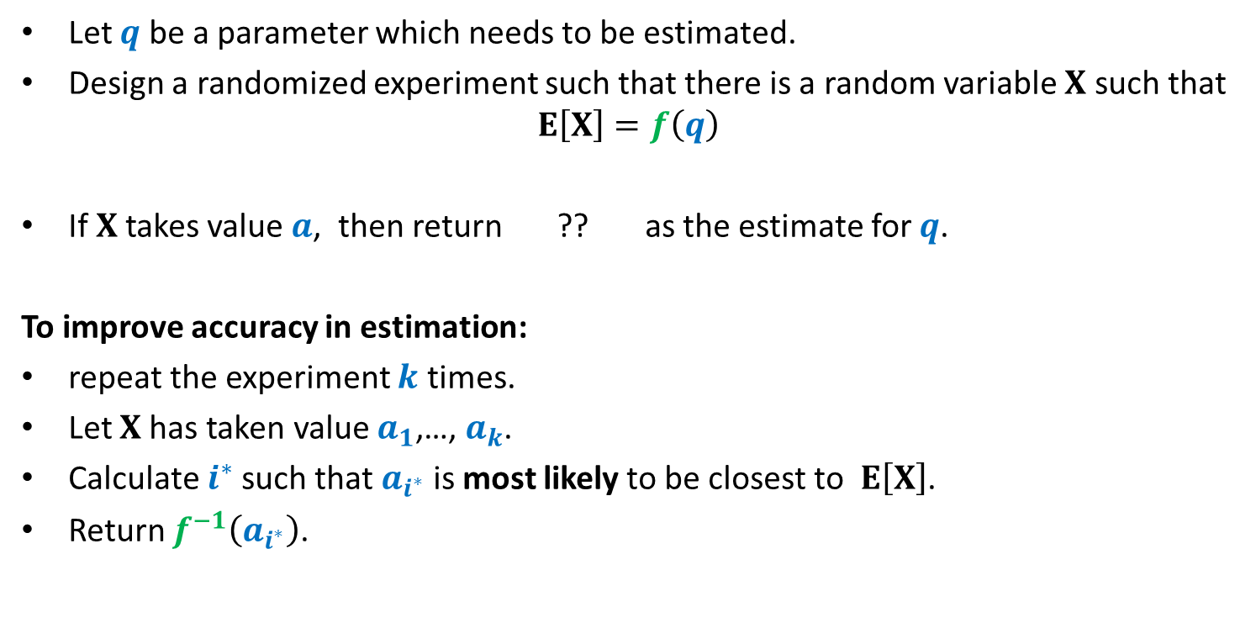
Randomized framework for estimating a parameter
Let $q$ be a parameter which needs to be estimated.
Design a randomized experiment such that there is a random variable $X$ such that
$$E\left[X\right]=f\left(q\right)$$
If $X$takes value $a$, then return ?? as the estimate for $q$.
To improve accuracy in estimation:
repeat the experiment $k$ times.
Let $X$has taken value $a_{1}$,…, $a_{k}$.
Calculate $i^{∗}$such that $a_{i^{∗}}$ is most likely to be closest to $E\left[X\right]$.
Return $f^{−1}\left(a_{i^{∗}}\right)$.
$$f^{−1}\left(a\right)$$

Slide 4
Estimating the size of Transitive Closure of a Directed Graph

Slide 5
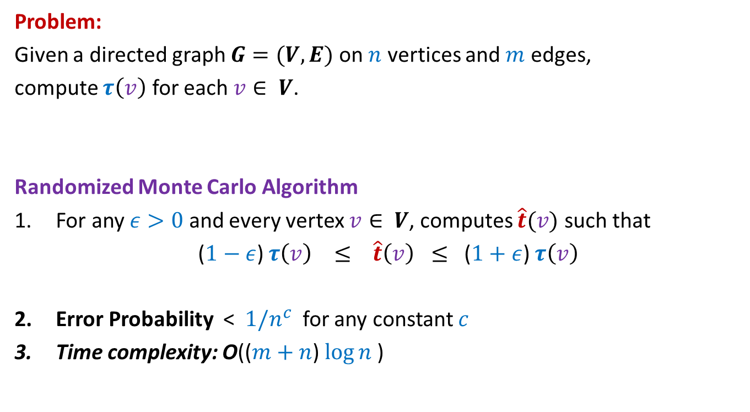
Estimating size of Transitive Closure of a Directed Graph
Problem:
Given a directed graph $G=(V,E)$ on $n$ vertices and $m$ edges,
compute $τ\left(v\right)$ for each $v∈ V$.
Randomized Monte Carlo Algorithm
For any $ε>0$ and every vertex $v∈ V$, computes $\hat{t}(v)$ such that
($1−ε$) $τ\left(v\right) ≤ \hat{t}\left(v\right) ≤$ ($1+ε$) $τ\left(v\right)$
Error Probability < $1/n^{c}$ for any constant $c$
Time complexity: O(($m+n$) $\log{n}$)

Slide 6








Sampling points on a line segment
$$\frac{1}{n+1}$$
Question: What is E[$X_{i}]$ ?
Answer:
1
0
1
0
$$X_{n}$$
$$X_{n+1}$$
$$X_{1}$$
$$X_{2}$$
$$X_{3}$$
$$X_{4}$$

Slide 7
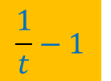
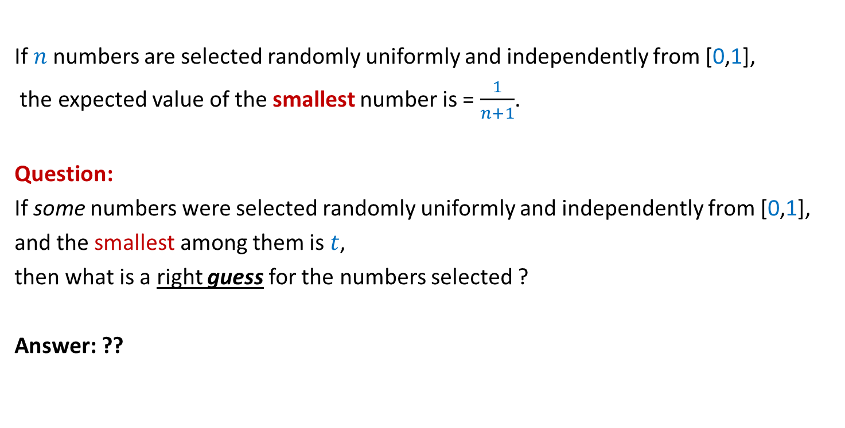
Inference from the inspirational problem
If $n$numbers are selected randomly uniformly and independently from [0,1],
the expected value of the smallest number is = $\frac{1}{n+1}$.
Question:
If some numbers were selected randomly uniformly and independently from [0,1],
and the smallest among them is $t$,
then what is a right guess for the numbers selected ?
Answer: ??
$$\frac{1}{t}−1$$
Spend some time now to design the algorithm based on this insight.

Slide 8
Randomized Monte Carlo algorithm
Estimating
the size of Transitive Closure
of a Directed Graph

Slide 9

$$x$$

Slide 10






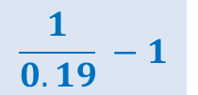
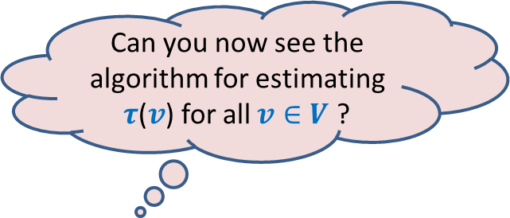
Suppose each vertex reachable from $x$ is assigned
a random no. uniformly distributed in the interval [$0,1$].
If we know the MinLabel($x$), how can we estimate $τ$($v$) ?
Can you now see the algorithm for estimating $τ$($v$) for all $v∈V$ ?
0.38
0.83
$$x$$
0.19
0.53
0.45
Estimate $\hat{τ}$($v$) :
$$\frac{1}{0.19} −1$$
$$=4.26$$
0.71
$$≈$$
$τ$($v$) :
$$=6$$

Slide 11
0.65
0.265
0.901
0.81
0.28
0.34
0.49
0.54
0.63
0.38
0.83
0.14
0.74
0.19
0.53
0.45
0.71

Slide 12
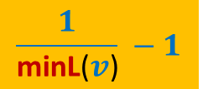
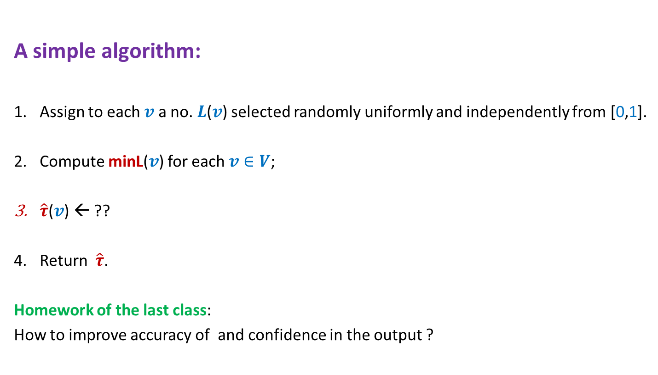
Estimating size of Transitive Closure of a Directed Graph
A simple algorithm:
Assign to each $v$ a no. $L$($v$) selected randomly uniformly and independently from [0,1].
Compute minL($v$) for each $v∈V$;
$\hat{τ}$($v$) ← ??
Return $\hat{τ}$.
Homework of the last class:
How to improve accuracy of and confidence in the output ?
$$\frac{1}{\text{minL}\text{(}v\text{)}} −1$$

Slide 13
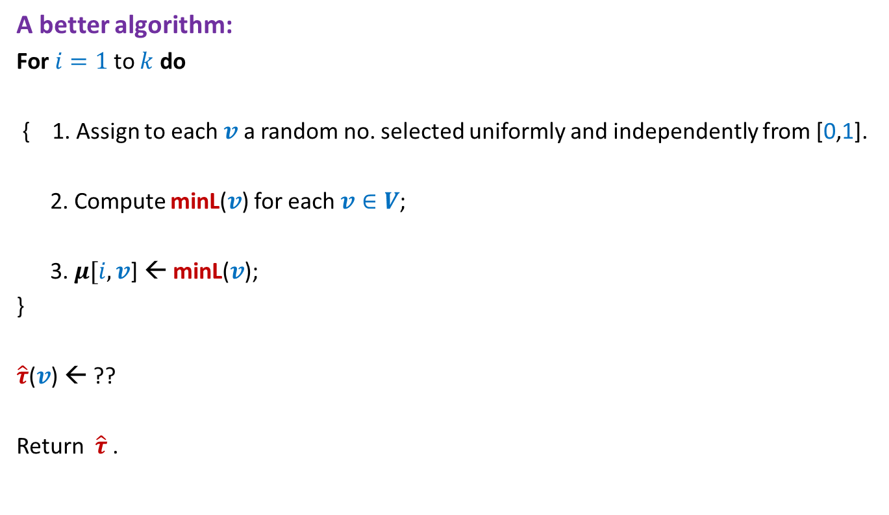
Estimating size of Transitive Closure of a Directed Graph
A better algorithm:
For $i=1$to $k$ do
{ 1. Assign to each $v$ a random no. selected uniformly and independently from [0,1].
2. Compute minL($v$) for each $v∈V$;
3. $μ[i,v$] ← minL($v$);
}
$\hat{τ}$($v$) ← ??
Return $\hat{τ}$.

Slide 14

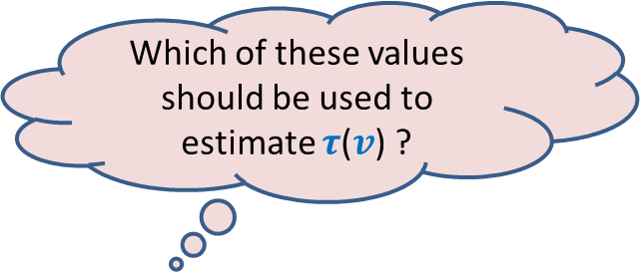

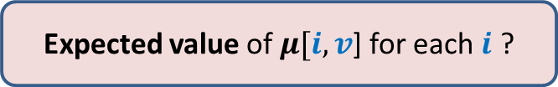

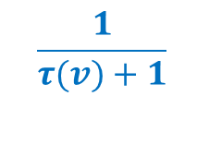
$\{μ[1,v$], $μ[2,v$], …, $μ[k,v]$}
Question 1: Which value among $\{μ[1,v$], …, $μ[k,v]$} is likely to be closest to $\frac{1}{τ(v)+1}$?
Question 2: How many of$\{μ[1,v$], …, $μ[k,v]$} are likely to have value $≥\frac{1}{τ(v)+1}$ ?
Question 3: What is the probability that $μ[i,v$] for any fixed $i$ is $≥\frac{1}{τ(v)+1}$
Answer: (Hint: for this to happen all vertices in Reach($v$) must get $L$() $≥\frac{1}{τ(v)+1}$)
This probability is = ${\left(1− \frac{1}{τ\left(v\right)+1}\right)}^{τ\left(v\right)}$≈ $\frac{1}{e}$
Which of these values should be used to estimate $τ$($v$) ?
$$\frac{k}{e}$$
Can you answer Question 2 now ?
0
1
$$\frac{1}{τ(v)+1}$$
Expected value of $μ[i,v$] for each $i$ ?

Slide 15
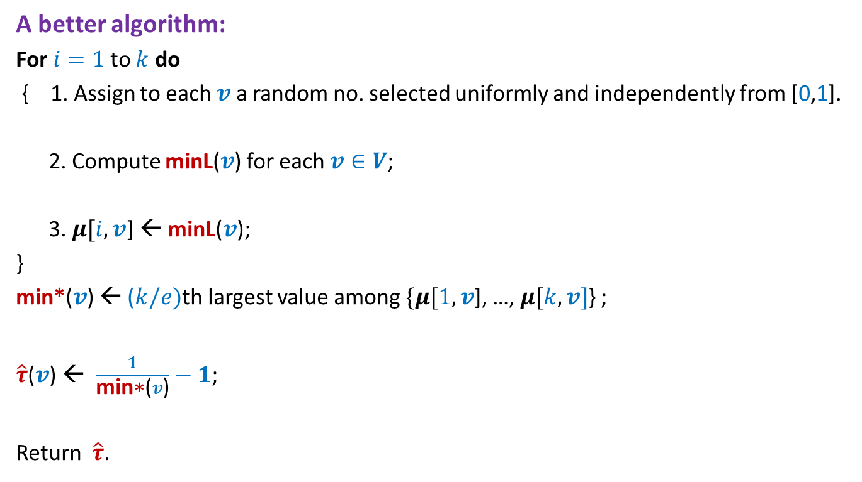
Estimating size of Transitive Closure of a Directed Graph
A better algorithm:
For $i=1$to $k$ do
{ 1. Assign to each $v$ a random no. selected uniformly and independently from [0,1].
2. Compute minL($v$) for each $v∈V$;
3. $μ[i,v$] ← minL($v$);
}
min*($v$) ← ($k/e)$th largest value among $\{μ[1,v$], …, $μ[k,v]$} ;
$\hat{τ}$($v$) ← $\frac{1}{\text{min}\text{∗}\text{(}v\text{)}}−1$;
Return $\hat{τ}$.

Slide 16
Homework
Use Chernoff bound to get a high probability bound on the error.
(Will not be asked in any exam or quiz.But those who have interest in randomized algorithm should sincerely attempt for their own fun/joy)

Slide 17
Random Sampling
(To efficiently find a subset
with a desired property)

Slide 18
Random Sampling
Suppose there is a computational problem
where we require to find a subset with some desired properties.
Unfortunately, computing such a set deterministically
looks just too difficult and/or may take huge time.
Random sampling carried out suitably
may produce a subset with the desired property with some probability.

Slide 19
A real life example
We need a donor with blood group O+.
There is a huge list (1 million) of blood donors.
Unfortunately, the blood group information of donors is lost .
What to do ?
IDEA:
Repeat until we get a donor of blood group O+.
{ Pick phone number of a donor randomly uniformly
Call him to ask his Blood group.
}
37% people are O+
(Select a random subset of donors.)

Slide 20

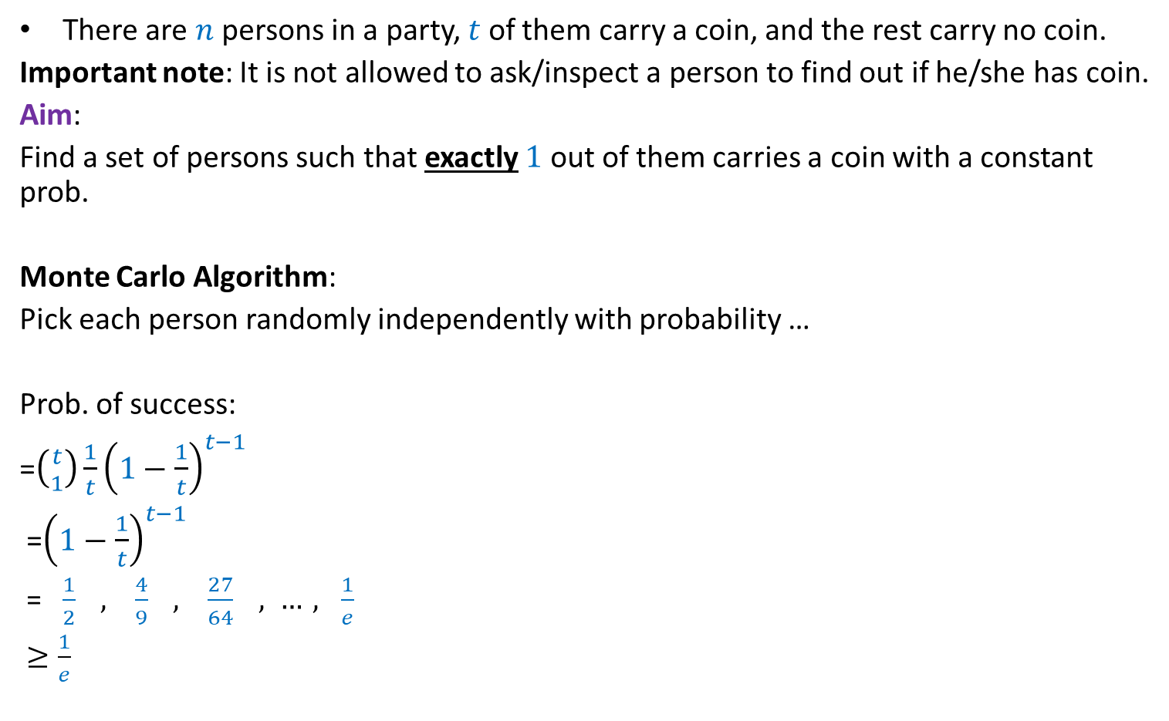
A generic example
There are $n$ persons in a party, $t$ of them carry a coin, and the rest carry no coin.
Important note: It is not allowed to ask/inspect a person to find out if he/she has coin.
Aim:
Find a set of persons such that exactly $1$ out of them carries a coin with a constant prob.
Monte Carlo Algorithm:
Pick each person randomly independently with probability …
Prob. of success:
=$\left({t \atop 1}\right)\frac{1}{t}{\left(1−\frac{1}{t}\right)}^{t−1}$
=${\left(1−\frac{1}{t}\right)}^{t−1}$
= $\frac{1}{2} , \frac{4}{9} , \frac{27}{64} , …, \frac{1}{e}$
$≥\frac{1}{e}$
$$\frac{1}{t}$$

Slide 21
Randomized Algorithm for
BPWM problem
(Boolean Product Witness Matrix)

Slide 22

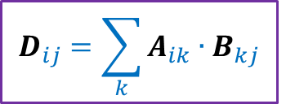

Integer Product of Matrices
Boolean
$$j$$
$$j$$
1 | 0 | 0 | 1 | 0
1 | 0 | 0 | 0 | 1
0 | 0 | 1 | 0 | 0
0 | 1 | 0 | 1 | 0
1 | 1 | 0 | 1 | 0
1 | 0 | 1 | 0 | 0
0 | 1 | 1 | 0 | 1
1 | 1 | 1 | 1 | 0
1 | 1 | 1 | 0 | 0
1 | 0 | 0 | 1 | 0
2 | 1 | 2 | 0 | 0
2 | 0 | 1 | 0 | 0
1 | 1 | 1 | 1 | 0
1 | 2 | 2 | 0 | 1
2 | 2 | 3 | 0 | 1
$$i$$
$$i$$
A
B
D
$$D_{ij}=\sum_{k}{A_{ik}{∙B}_{kj}}$$

Slide 23
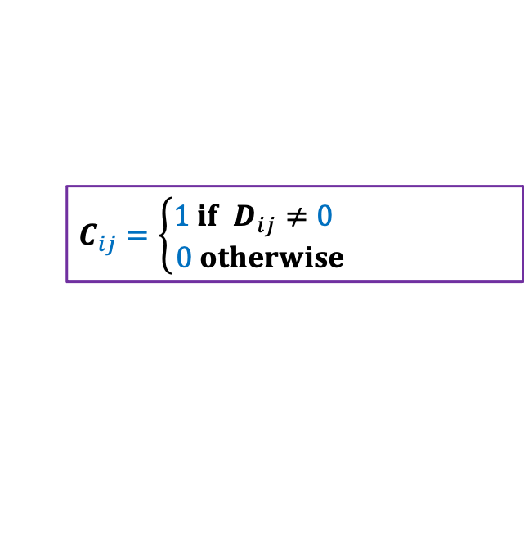
Boolean Product of Matrices
$$j$$
1 | 0 | 0 | 1 | 0
1 | 0 | 0 | 0 | 1
0 | 0 | 1 | 0 | 0
0 | 1 | 0 | 1 | 0
1 | 1 | 0 | 1 | 0
1 | 0 | 0 | 1 | 0
1 | 0 | 0 | 0 | 1
0 | 0 | 1 | 0 | 0
0 | 1 | 0 | 1 | 0
1 | 1 | 0 | 1 | 0
1 | 0 | 1 | 0 | 0
0 | 1 | 1 | 0 | 1
1 | 1 | 1 | 1 | 0
1 | 1 | 1 | 0 | 0
1 | 0 | 0 | 1 | 0
1 | 1 | 1 | 0 | 0
1 | 0 | 1 | 0 | 0
1 | 1 | 1 | 1 | 0
1 | 1 | 1 | 0 | 1
1 | 1 | 1 | 0 | 1
$$i$$
A
B
C
$$C_{ij}=\left\{\begin{aligned}1 if D_{ij}≠0 \\ 0 otherwise \end{aligned}\right.$$

Slide 24
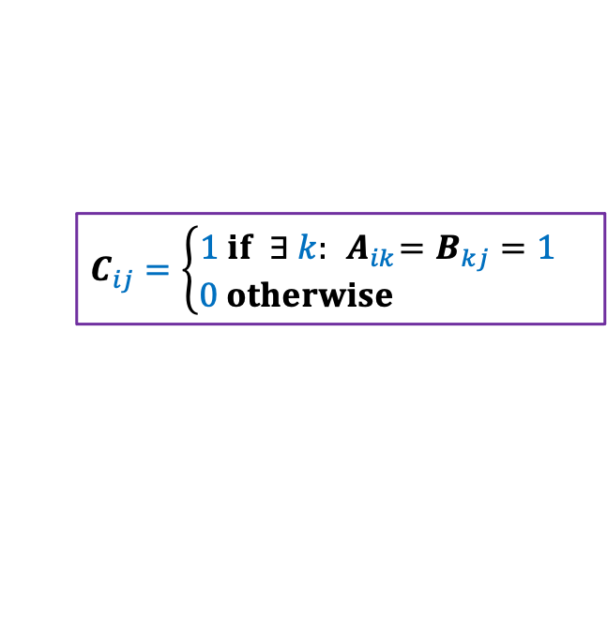
Boolean Product of Matrices
$$j$$
1 | 0 | 0 | 1 | 0
1 | 0 | 0 | 0 | 1
0 | 0 | 1 | 0 | 0
0 | 1 | 0 | 1 | 0
1 | 1 | 0 | 1 | 0
1 | 0 | 0 | 1 | 0
1 | 0 | 0 | 0 | 1
0 | 0 | 1 | 0 | 0
0 | 1 | 0 | 1 | 0
1 | 1 | 0 | 1 | 0
1 | 0 | 1 | 0 | 0
0 | 1 | 1 | 0 | 1
1 | 1 | 1 | 1 | 0
1 | 1 | 1 | 0 | 0
1 | 0 | 0 | 1 | 0
1 | 1 | 1 | 0 | 0
1 | 0 | 1 | 0 | 0
1 | 1 | 1 | 1 | 0
1 | 1 | 1 | 0 | 1
1 | 1 | 1 | 0 | 1
$$i$$
A
B
C
$$C_{ij}=\left\{\begin{aligned}1 if ∃ k:{ A}_{ik}=B_{kj}=1 \\ 0 otherwise \end{aligned}\right.$$
Definition: An integer $k∈[n]$is said to be witness for a pair ($i,j$) if ${ A}_{ik}=B_{kj}=1$

Slide 25

Boolean Product Witness Matrix (BPWM)
Problem:
Given two Boolean matrices A and B, and their Boolean product C,
compute a matrix $W$, such that:
$W_{ij}$ stores a witness for each ($i,j$) with $C_{ij}=1$.

Slide 26
Motivation for BPWM

Slide 27





All Pairs Shortest Paths (APSP)
Standard Algorithms:
Floyd Warshal Algorithm
Dijkstra’s Algorithm
BFS traversal (for unweighted graphs)
O$(n^{3})$ time in the worst case
Raimund Seidel,
JCSS, 51(3): 400-403 ,$1995$
APSP
Matrix Multiplication
O$(n^{ω}\log^{2}{n})$ time
O$(n^{ω})$ time
$ω$<$2.317$

Slide 28
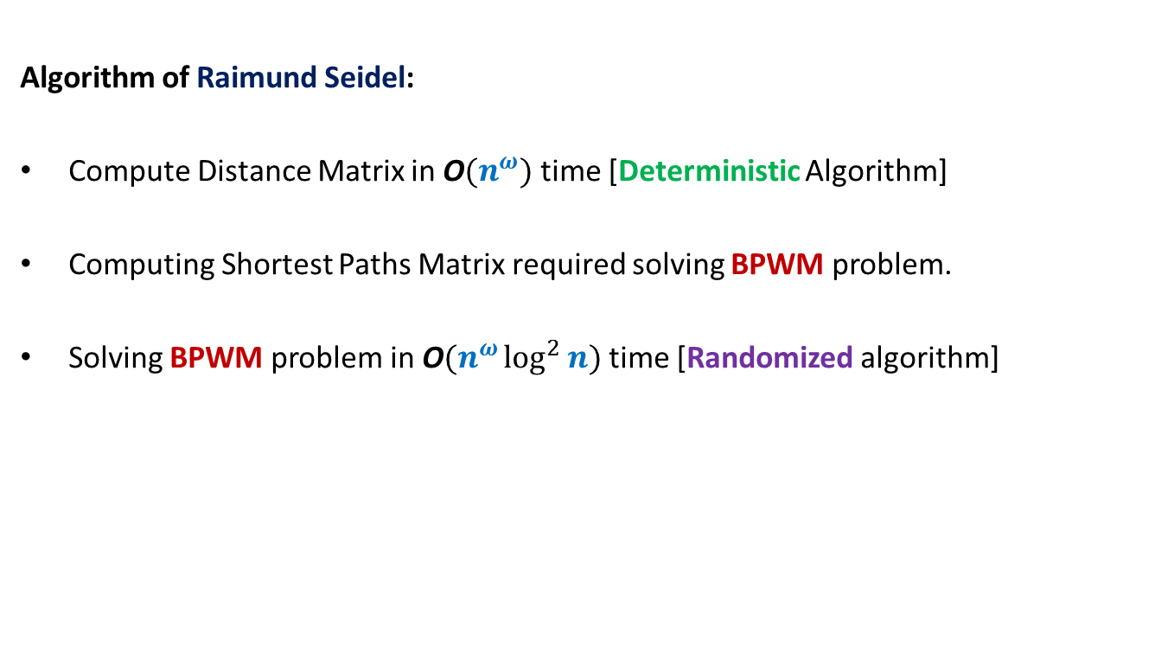
All Pairs Shortest Paths (APSP)
Algorithm of Raimund Seidel:
Compute Distance Matrix in O$(n^{ω})$ time [Deterministic Algorithm]
Computing Shortest Paths Matrix required solving BPWM problem.
Solving BPWM problem in O$(n^{ω}\log^{2}{n})$ time [Randomized algorithm]

Slide 29
Randomized algorithm for BPWM

Slide 30

Boolean Product Witness Matrix (BPWM)
Problem: Given two Boolean matrices A and B, and their Boolean product C,
compute a matrix $W$, such that:
$W_{ij}$ stores a witness for each ($i,j$) with $C_{ij}=1$.
Let us make some simple observations first.

Slide 31


Observations
$$j$$
1 | 0 | 0 | 1 | 0
1 | 0 | 0 | 0 | 1
0 | 0 | 1 | 0 | 0
0 | 1 | 0 | 1 | 0
1 | 1 | 0 | 1 | 0
1 | 0 | 1 | 0 | 0
0 | 1 | 1 | 0 | 1
1 | 1 | 1 | 1 | 0
1 | 1 | 1 | 0 | 0
1 | 0 | 0 | 1 | 0
1 | 1 | 1 | 0 | 0
1 | 0 | 1 | 0 | 0
1 | 1 | 1 | 1 | 0
1 | 1 | 1 | 0 | 1
1 | 1 | 1 | 0 | 1
$$i$$
A
B
C
There may be many witnesses for a pair ($i,j$) .
But our aim is to compute “just one witness” for each pair.
Witnesses for ($i$,$j$)

Slide 32

Observations
$$j$$
1 | 0 | 0 | 1 | 0
1 | 0 | 0 | 0 | 1
0 | 0 | 1 | 0 | 0
0 | 1 | 0 | 1 | 0
1 | 1 | 0 | 1 | 0
1 | 0 | 1 | 0 | 0
0 | 1 | 1 | 0 | 1
1 | 1 | 1 | 1 | 0
1 | 1 | 1 | 0 | 0
1 | 0 | 0 | 1 | 0
1 | 1 | 1 | 0 | 0
1 | 0 | 1 | 0 | 0
1 | 1 | 1 | 1 | 0
1 | 1 | 1 | 0 | 1
1 | 1 | 1 | 0 | 1
$$i$$
A
B
C
How efficiently can we search a witnesses for a pair ($i,j$) ?
O($n$) time

Slide 33


Observations
$$j$$
1 | 0 | 0 | 1 | 0
1 | 0 | 0 | 0 | 1
0 | 0 | 1 | 0 | 0
0 | 1 | 0 | 1 | 0
1 | 1 | 0 | 1 | 0
1 | 0 | 1 | 0 | 0
0 | 1 | 1 | 0 | 1
1 | 1 | 1 | 1 | 0
1 | 1 | 1 | 0 | 0
1 | 0 | 0 | 1 | 0
1 | 1 | 1 | 0 | 0
1 | 0 | 1 | 0 | 0
1 | 1 | 1 | 1 | 0
1 | 1 | 1 | 0 | 1
1 | 1 | 1 | 0 | 1
$$i$$
A
B
C
How efficiently can you verify if $k$ is a witness for a pair ($i,j$) ?
Just check whether${ A}_{ik}=B_{kj}=1$.
O($1$) time

Slide 34



Boolean Product of Matrices
$$j$$
1 | 0 | 0 | 1 | 0
1 | 0 | 0 | 0 | 1
0 | 0 | 1 | 0 | 0
0 | 1 | 0 | 1 | 0
1 | 1 | 0 | 1 | 0
1 | 0 | 1 | 0 | 0
0 | 1 | 1 | 0 | 1
1 | 1 | 1 | 1 | 0
1 | 1 | 1 | 0 | 0
1 | 0 | 0 | 1 | 0
1 | 1 | 1 | 0 | 0
1 | 0 | 1 | 0 | 0
1 | 1 | 1 | 1 | 0
1 | 1 | 1 | 0 | 1
1 | 1 | 1 | 0 | 1
$$i$$
A
B
C
Look carefully at the integer product matrix D. Does it have any thing to do with witnesses.
$D_{ij}$= number of witnesses for ($i,j$)
Integer
Product
2 | 1 | 2 | 0 | 0
2 | 0 | 1 | 0 | 0
1 | 1 | 1 | 1 | 0
1 | 2 | 2 | 0 | 1
2 | 2 | 3 | 0 | 1
So it is worth studying $D$ for our problem
$$D_{ij}=\sum_{k}{A_{ik}{∙B}_{kj}}$$
D
Notes:
C just stores 0-1 entries and does not provide any information about witnesses.
Let us look at matrix D which stores some numbers …

Slide 35
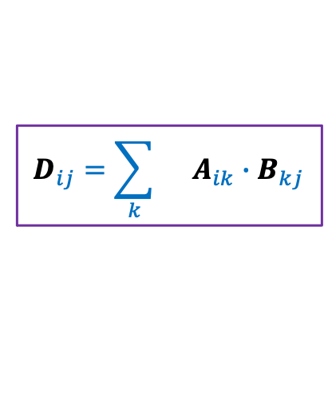
Integer Product of Matrices
1 | 0 | 0 | 1 | 0
1 | 0 | 0 | 0 | 1
0 | 0 | 1 | 0 | 0
0 | 1 | 0 | 1 | 0
1 | 1 | 0 | 1 | 0
1 | 0 | 1 | 0 | 0
0 | 1 | 1 | 0 | 1
1 | 1 | 1 | 1 | 0
1 | 1 | 1 | 0 | 0
1 | 0 | 0 | 1 | 0
2 | 1 | 2 | 0 | 0
2 | 0 | 1 | 0 | 0
1 | 1 | 1 | 1 | 0
1 | 2 | 2 | 0 | 1
2 | 2 | 3 | 0 | 1
A
B
D
$$D_{ij}=\sum_{k}{ A_{ik}{∙B}_{kj}}$$

Slide 36
Integer Product of Matrices
1 | 0 | 0 | 1 | 0
1 | 0 | 0 | 0 | 1
0 | 0 | 1 | 0 | 0
0 | 1 | 0 | 1 | 0
1 | 1 | 0 | 1 | 0
1 | 0 | 1 | 0 | 0
0 | 1 | 1 | 0 | 1
1 | 1 | 1 | 1 | 0
1 | 1 | 1 | 0 | 0
1 | 0 | 0 | 1 | 0
2 | 1 | 2 | 0 | 0
2 | 0 | 1 | 0 | 0
1 | 1 | 1 | 1 | 0
1 | 2 | 2 | 0 | 1
2 | 2 | 3 | 0 | 1
A
B
D
$$D_{ij}=\sum_{k}{ A_{ik}{∙B}_{kj}}$$

Slide 37

Integer Product of Matrices
1
2
3
4
5
⨯
⨯
⨯
⨯
⨯
1 | 0 | 0 | 1 | 0
1 | 0 | 0 | 0 | 1
0 | 0 | 1 | 0 | 0
0 | 1 | 0 | 1 | 0
1 | 1 | 0 | 1 | 0
1 | 0 | 1 | 0 | 0
0 | 1 | 1 | 0 | 1
1 | 1 | 1 | 1 | 0
1 | 1 | 1 | 0 | 0
1 | 0 | 0 | 1 | 0
2 | 1 | 2 | 0 | 0
2 | 0 | 1 | 0 | 0
1 | 1 | 1 | 1 | 0
1 | 2 | 2 | 0 | 1
2 | 2 | 3 | 0 | 1
A
B
D
$$D_{ij}=\sum_{k}{ A_{ik}{∙B}_{kj}}$$
$$k⋅$$
There is a way to manipulate A so that D will store a witness for all those pairs which have singleton witness. Can you guess ?

Slide 38
Integer Product of Matrices
1
2
3
4
5
⨯
⨯
⨯
⨯
⨯
1 | 0 | 0 | 1 | 0
1 | 0 | 0 | 0 | 1
0 | 0 | 1 | 0 | 0
0 | 1 | 0 | 1 | 0
1 | 1 | 0 | 1 | 0
1 | 0 | 1 | 0 | 0
0 | 1 | 1 | 0 | 1
1 | 1 | 1 | 1 | 0
1 | 1 | 1 | 0 | 0
1 | 0 | 0 | 1 | 0
2 | 4 | 2 | 0 | 0
2 | 0 | 1 | 0 | 0
3 | 3 | 3 | 3 | 0
2 | 2 | 2 | 0 | 2
2 | 2 | 3 | 0 | 2
A
B
D
$$D_{ij}=\sum_{k}{ A_{ik}{∙B}_{kj}}$$
$$k⋅$$

Slide 39
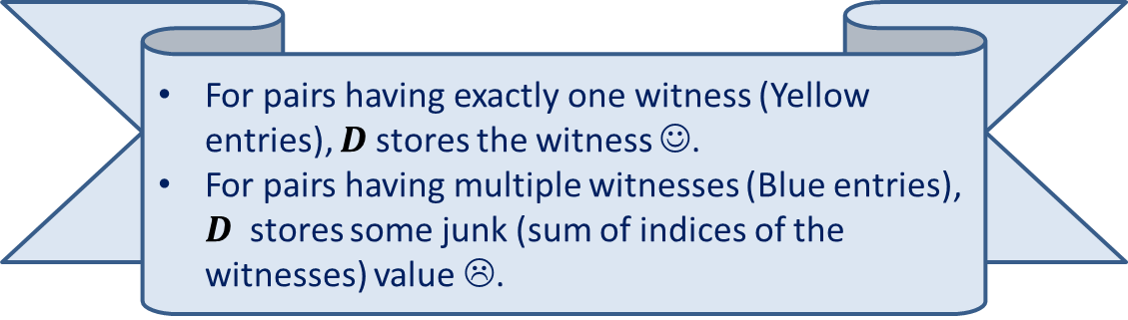
Integer Product of Matrices
1 2 3 4 5
⨯ ⨯ ⨯ ⨯ ⨯
1 | 0 | 0 | 1 | 0
1 | 0 | 0 | 0 | 1
0 | 0 | 1 | 0 | 0
0 | 1 | 0 | 1 | 0
1 | 1 | 0 | 1 | 0
1 | 0 | 1 | 0 | 0
0 | 1 | 1 | 0 | 1
1 | 1 | 1 | 1 | 0
1 | 1 | 1 | 0 | 0
1 | 0 | 0 | 1 | 0
5 | 4 | 5 | 0 | 0
6 | 0 | 1 | 0 | 0
3 | 3 | 3 | 3 | 0
2 | 6 | 6 | 0 | 2
5 | 6 | 7 | 0 | 2
A
B
D
For pairs having exactly one witness (Yellow entries), $D$stores the witness ☺.
For pairs having multiple witnesses (Blue entries), $D$ stores some junk (sum of indices of the witnesses) value ☹.

Slide 40

Algorithm for Computing Singleton Witnesses
Compute-Singleton-Witnesses($A$,$B$)
{ For each $i,k∈[n]$
$A_{ik}$← $k$∙ $A_{ik}$;
$D′$← $A$ ∙ $B$;
For each $i,j∈[n]$
If $D_{ij}^{′}$ is a witness for ($i,j$)
$W_{ij}$← $D_{ij}^{′}$
}
Time complexity: O$(n^{ω})$
A deterministic Algorithm

Slide 41
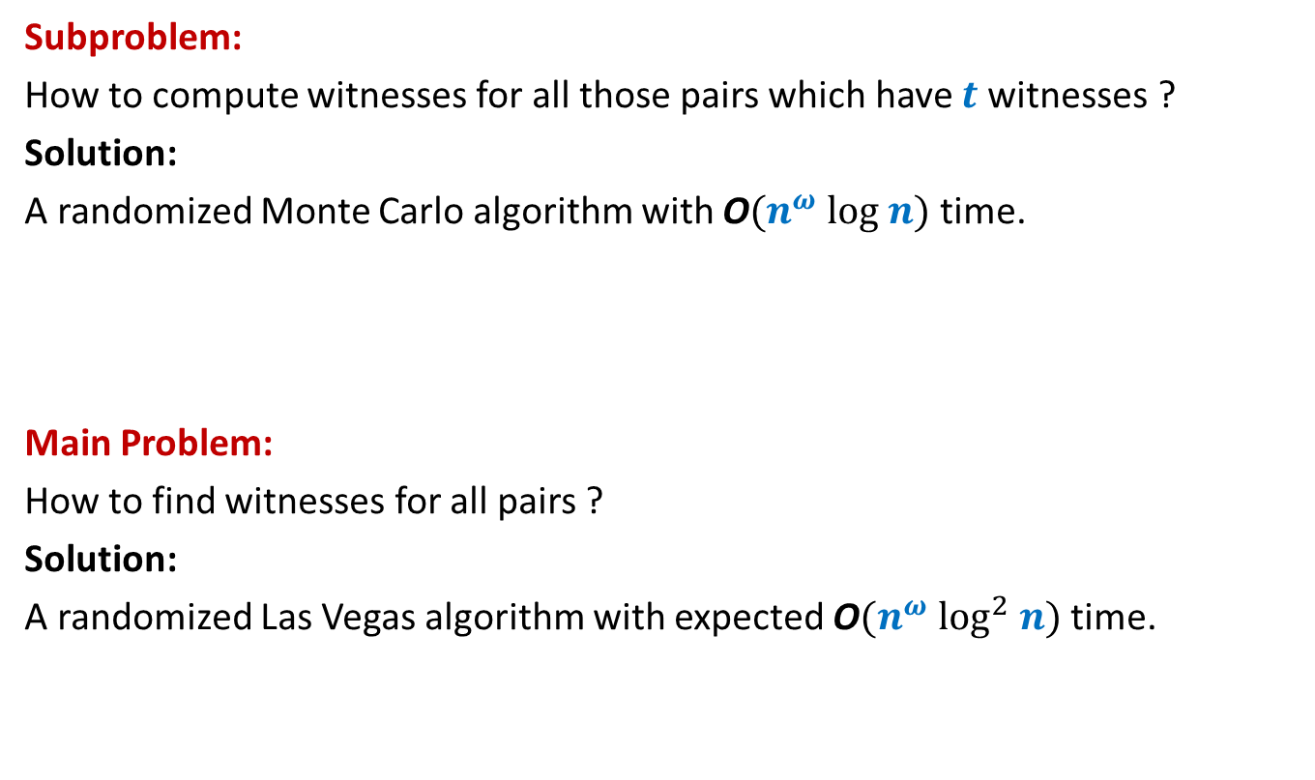
Algorithm Design for BPWM
Subproblem:
How to compute witnesses for all those pairs which have $t$witnesses ?
Solution:
A randomized Monte Carlo algorithm with O$(n^{ω} log n)$ time.
Main Problem:
How to find witnesses for all pairs ?
Solution:
A randomized Las Vegas algorithm with expected O$(n^{ω} \log^{2} n)$ time.
?

Slide 42
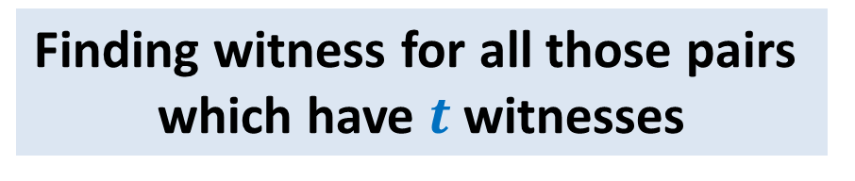

Randomized O$(n^{ω} log n)$ Algorithm:
Finding witness for all those pairs
which have $t$witnesses

Slide 43

Focus on a single pair ($i$,$j$)
$$j$$
1 | 0 | 1 | 1 | 1 | 0 | 0 | 1 | 0 | 1
 |  |  |  |  |  |  | 1
 |  |  |  |  |  |  | 1
 |  |  |  |  |  |  | 0
 |  |  |  |  |  |  | 1
 |  |  |  |  |  |  | 1
 |  |  |  |  |  |  | 0
 |  |  |  |  |  |  | 1
 |  |  |  |  |  |  | 1
 |  |  |  |  |  |  | 0
 |  |  |  |  |  |  | 0
$$i$$
A
B

Slide 44


Focus on a single pair ($i$,$j$)
$$j$$
1 2 3 4 … n
⨯ ⨯ ⨯ ⨯ ⨯ ⨯ ⨯ ⨯ ⨯ ⨯
1 | 0 | 1 | 1 | 1 | 0 | 0 | 1 | 0 | 1
 |  |  |  |  |  |  | 1
 |  |  |  |  |  |  | 1
 |  |  |  |  |  |  | 0
 |  |  |  |  |  |  | 1
 |  |  |  |  |  |  | 1
 |  |  |  |  |  |  | 0
 |  |  |  |  |  |  | 1
 |  |  |  |  |  |  | 1
 |  |  |  |  |  |  | 0
 |  |  |  |  |  |  | 0
$$i$$
A
B
How to nullify the effect of $t−1$witnesses ?
Witnesses for ($i$,$j$)

Slide 45
Focus on a single pair ($i$,$j$)
$$j$$
1 2 3 4 … n
⨯ ⨯ ⨯ ⨯ ⨯ ⨯ ⨯ ⨯ ⨯ ⨯
1 | 0 | 1 | 1 | 1 | 0 | 0 | 1 | 0 | 1
 |  |  |  |  |  |  | 1
 |  |  |  |  |  |  | 1
 |  |  |  |  |  |  | 0
 |  |  |  |  |  |  | 1
 |  |  |  |  |  |  | 1
 |  |  |  |  |  |  | 0
 |  |  |  |  |  |  | 1
 |  |  |  |  |  |  | 1
 |  |  |  |  |  |  | 0
 |  |  |  |  |  |  | 0
$$i$$
A
B

Slide 46
Focus on a single pair ($i$,$j$)
$$j$$
1 2 3 4 5 … n-1 n
⨯ ⨯ ⨯ ⨯ ⨯ ⨯ ⨯ ⨯ ⨯ ⨯
1 | 0 | 1 | 1 | 1 | 0 | 0 | 1 | 0 | 1
 |  |  |  |  |  |  | 1
 |  |  |  |  |  |  | 1
 |  |  |  |  |  |  | 0
 |  |  |  |  |  |  | 1
 |  |  |  |  |  |  | 1
 |  |  |  |  |  |  | 0
 |  |  |  |  |  |  | 1
 |  |  |  |  |  |  | 1
 |  |  |  |  |  |  | 0
 |  |  |  |  |  |  | 0
$$i$$
A
B

Slide 47

Focus on a single pair ($i$,$j$)
$$j$$
0 2 3 0 5 … n-1 0
⨯ ⨯ ⨯ ⨯ ⨯ ⨯ ⨯ ⨯ ⨯ ⨯
1 | 0 | 1 | 1 | 1 | 0 | 0 | 1 | 0 | 1
 |  |  |  |  |  |  | 1
 |  |  |  |  |  |  | 1
 |  |  |  |  |  |  | 0
 |  |  |  |  |  |  | 1
 |  |  |  |  |  |  | 1
 |  |  |  |  |  |  | 0
 |  |  |  |  |  |  | 1
 |  |  |  |  |  |  | 1
 |  |  |  |  |  |  | 0
 |  |  |  |  |  |  | 0
$$i$$
A
B
$D_{ij}$ will store this witness for ($i$,$j$) now ☺.

Slide 48
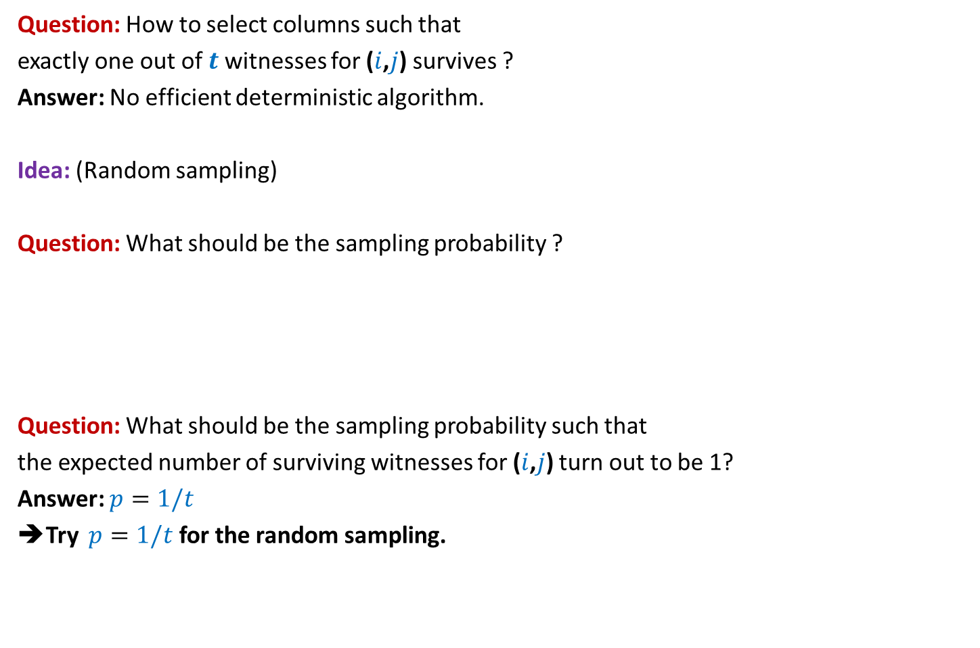
Focus on a single pair ($i$,$j$)
Question: How to select columns such that
exactly one out of $t$witnesses for ($i$,$j$) survives ?
Answer: No efficient deterministic algorithm.
Idea: (Random sampling)
Question: What should be the sampling probability ?
Question: What should be the sampling probability such that
the expected number of surviving witnesses for ($i$,$j$) turn out to be 1?
Answer: $p=1/t$
➔Try $p=1/t$ for the random sampling.
Recall the
generic example
No idea!
Let us ask the following related but easier question.

Slide 49

Focus on a single pair ($i$,$j$)
Question:
If each column is selected independently with $p=1/t$ ,
what is the probability that exactly one out of $t$witnesses for ($i$,$j$) survives ?
Answer:
=$\left({t \atop 1}\right)\frac{1}{t}{\left(1−\frac{1}{t}\right)}^{t−1}$
=${\left(1−\frac{1}{t}\right)}^{t−1}$
= $\frac{1}{2} , \frac{4}{9} , \frac{27}{64} , …, \frac{1}{e}$
$≥\frac{1}{e}$

Slide 50


Randomized algorithm for Computing Witnesses for all pairs with $t$witnesses
//The pseudo code for sampling the (indices of) columns
Sample($n$, $p$)
{ $R$← $∅$;
For each $k∈[n]$ do:
add $k$to $R$ with probability $p$;
return $R$;
}

Slide 51
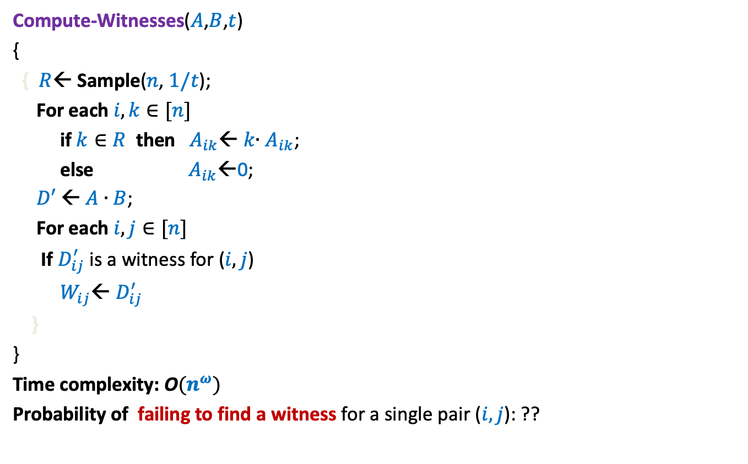

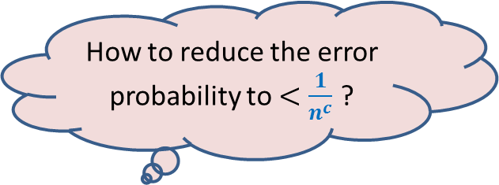
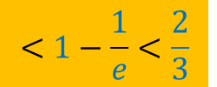
Randomized algorithm for Computing Witnesses for all pairs with $t$witnesses
Compute-Witnesses($A$,$B$,$t$)
{
{ $R$← Sample($n$, $1/t$);
For each $i,k∈[n]$
if $k∈R$ then $A_{ik}$← $k$∙ $A_{ik}$;
else $A_{ik}$←0;
$D′$← $A$ ∙ $B$;
For each $i,j∈[n]$
If $D_{ij}^{′}$ is a witness for ($i,j$)
$W_{ij}$← $D_{ij}^{′}$
}
}
Time complexity: O$(n^{ω})$
Probability of failing to find a witness for a single pair ($i,j$): ??
How to reduce the error probability to $<\frac{1}{n^{c}}$ ?
Repeat the entire process
${c log}_{3/2} n$ times.
$$<1−\frac{1}{e}<\frac{2}{3}$$

Slide 52
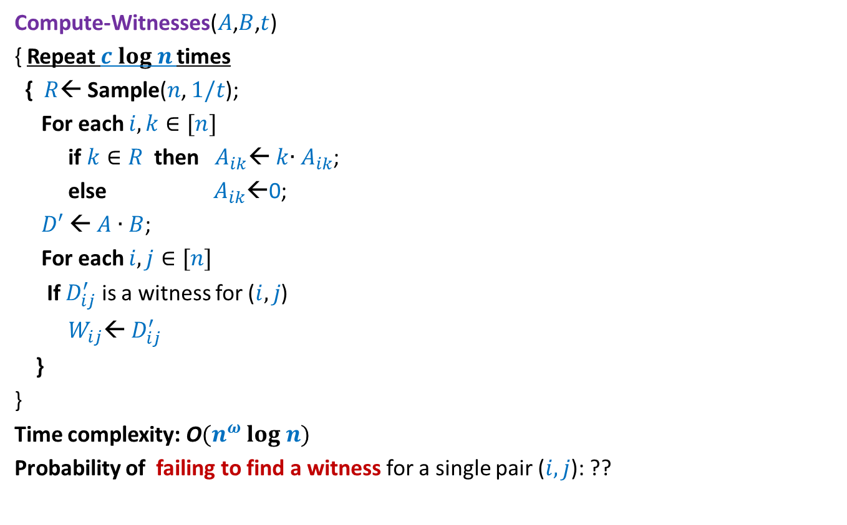
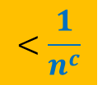
Randomized algorithm for Computing Witnesses for all pairs with $t$witnesses
Compute-Witnesses($A$,$B$,$t$)
{ Repeat $c log n$times
{ $R$← Sample($n$, $1/t$);
For each $i,k∈[n]$
if $k∈R$ then $A_{ik}$← $k$∙ $A_{ik}$;
else $A_{ik}$←0;
$D′$← $A$ ∙ $B$;
For each $i,j∈[n]$
If $D_{ij}^{′}$ is a witness for ($i,j$)
$W_{ij}$← $D_{ij}^{′}$
}
}
Time complexity: O$(n^{ω} log n)$
Probability of failing to find a witness for a single pair ($i,j$): ??
$$<\frac{1}{n^{c}}$$

Slide 53
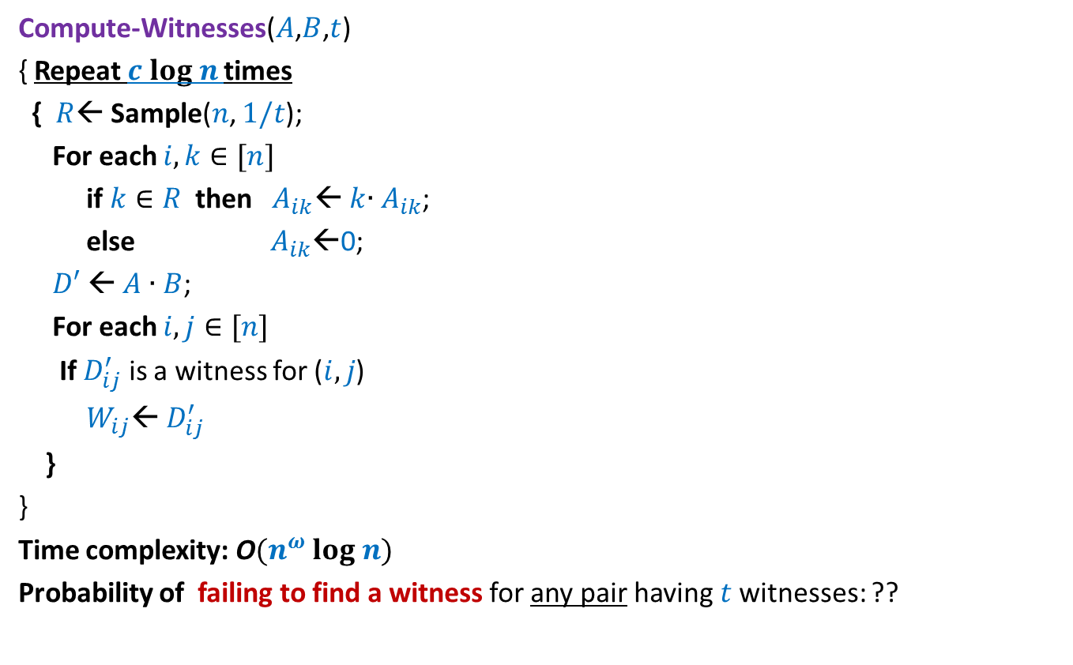
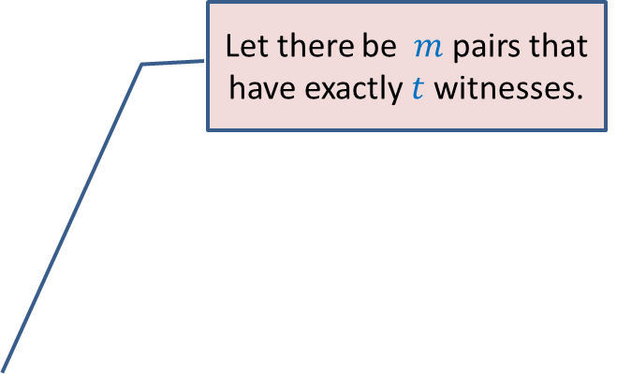

Randomized algorithm for Computing Witnesses for all pairs with $t$witnesses
Compute-Witnesses($A$,$B$,$t$)
{ Repeat $c log n$times
{ $R$← Sample($n$, $1/t$);
For each $i,k∈[n]$
if $k∈R$ then $A_{ik}$← $k$∙ $A_{ik}$;
else $A_{ik}$←0;
$D′$← $A$ ∙ $B$;
For each $i,j∈[n]$
If $D_{ij}^{′}$ is a witness for ($i,j$)
$W_{ij}$← $D_{ij}^{′}$
}
}
Time complexity: O$(n^{ω} log n)$
Probability of failing to find a witness for any pair having $t$witnesses: ??
Apply Union theorem …
Let there be $m$ pairs that have exactly $t$witnesses.
$<\frac{m}{n^{c}}$ < $\frac{1}{n^{c−2}}$

Slide 54
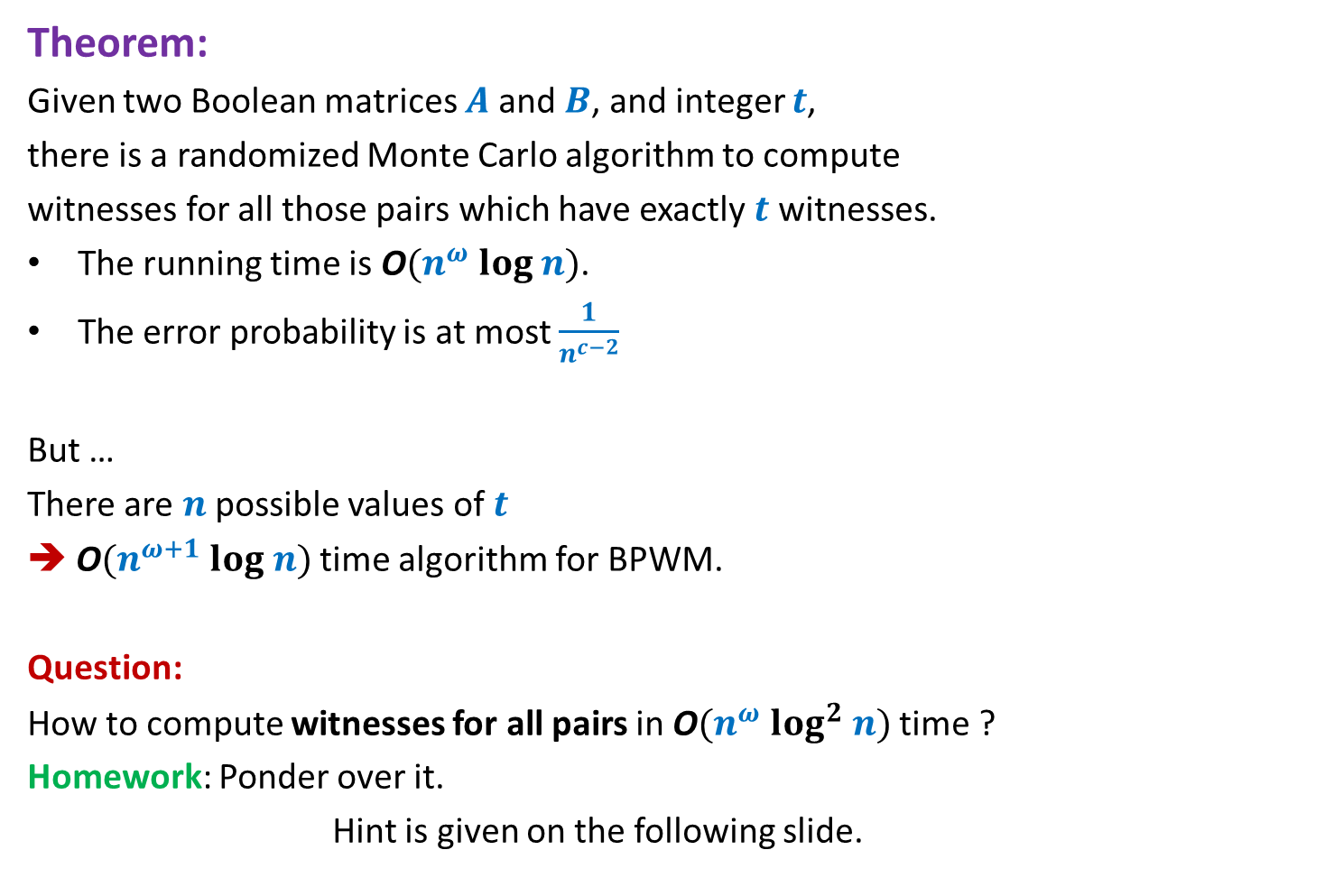
Theorem:
Given two Boolean matrices $A$and $B$, and integer $t$,
there is a randomized Monte Carlo algorithm to compute
witnesses for all those pairs which have exactly $t$ witnesses.
The running time is O$(n^{ω} log n)$.
The error probability is at most $\frac{1}{n^{c−2}}$
But …
There are $n$possible values of $t$
➔ O$(n^{ω+1} log n)$ time algorithm for BPWM.
Question:
How to compute witnesses for all pairs in O$(n^{ω} log^{2} n)$ time ?
Homework: Ponder over it.
Hint is given on the following slide.

Slide 55
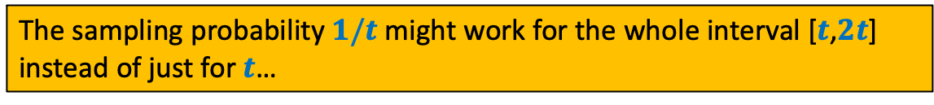






We seem to be too rigid in our approach
No. of witnesses | Sampling probability
$$t$$
$$1/t$$
$$t+1$$
$$1/(t+1)$$
…
…
$$2t$$
$$1/(2t)$$
The sampling probability $1/t$ might work for the whole interval [$t$,$2t$]
instead of just for $t$…

